Slide 1

Regression Using R
PsychoStat

Slide 2
Agenda
Simple (Bivariate) Regression
Multiple Regression
Adding Categorical Predictors
Mean-Centering Predictors
Adding Interactions (Moderation)

Slide 3

Simple Regression in R
PsychoStat

Slide 4
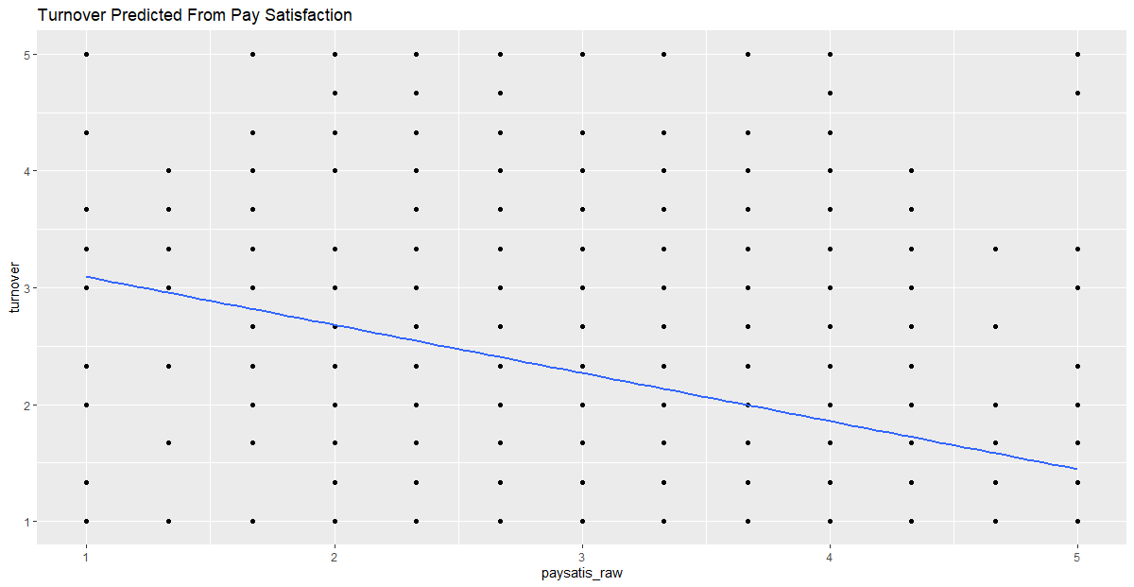
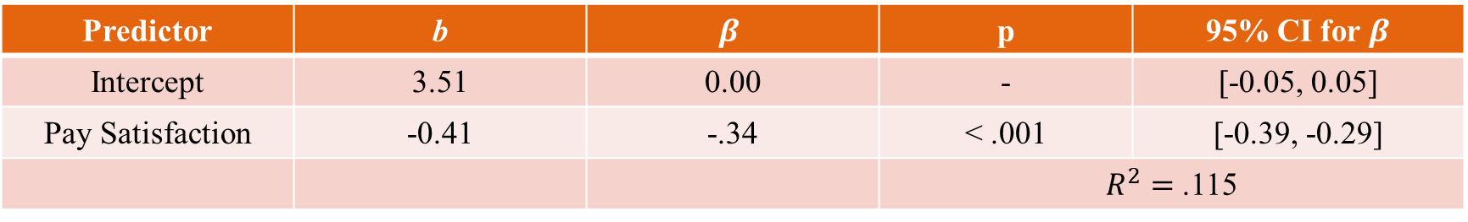
Simple Regression: Turnover ~ Pay Satisfaction
Predictor | b | $$β$$ | p | 95% CI for $β$
Intercept | 3.51 | 0.00 | - | [-0.05, 0.05]
Pay Satisfaction | -0.41 | -.34 | < .001 | [-0.39, -0.29]
 |  |  | $R^{2}=$ .115

Slide 5

Interpretation: Turnover ~ Pay Satisfaction
Predictor | b | $$β$$ | p | 95% CI for $β$
Intercept | 3.51 | 0.00 | - | [-0.05, 0.05]
Pay Satisfaction | -0.41 | -.34 | < .001 | [-0.39, -0.29]
 |  |  | $R^{2}=$ .116
The predicted level of turnover intentions for individuals with zero pay satisfaction is 3.51.
Not meaningful in this instance because pay satisfaction only measured from 1 to 5 (discussed later)
For every 1-unit increase in pay satisfaction, turnover intentions are predicted to decrease by 0.41 units.
For every 1-standard deviation increase in pay satisfaction, turnover intentions are predicted to decrease by 0.34 standard deviations
Roughly 11.6% of the variation in turnover intentions is explained by pay satisfaction.

Slide 6
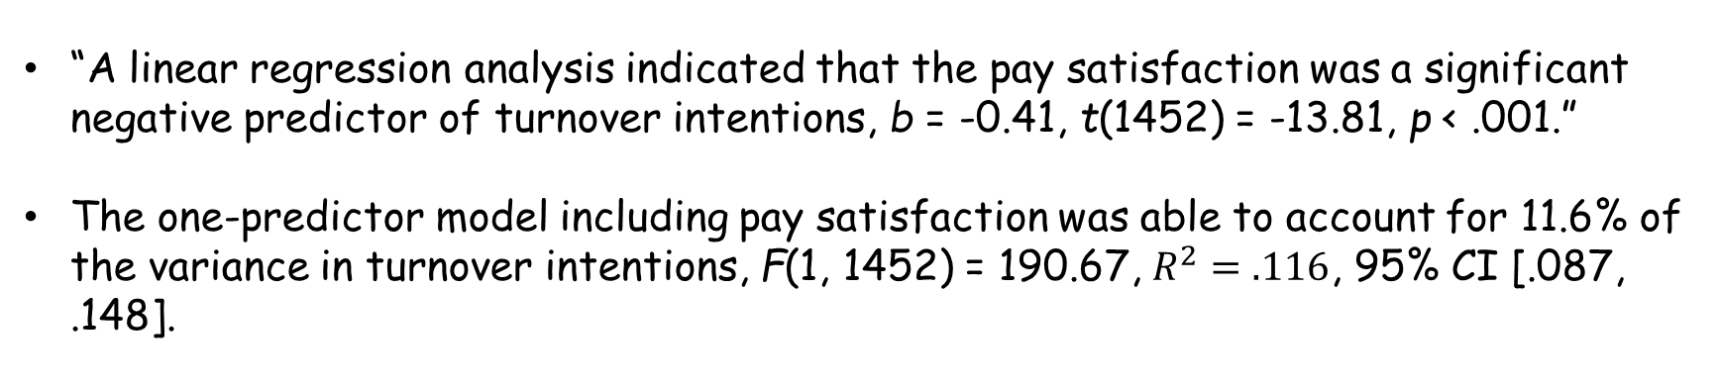
Fancy Write-Up: Turnover ~ Pay Satisfaction
Predictor | b | $$β$$ | p | 95% CI for $β$
Intercept | 3.51 | 0.00 | - | [-0.05, 0.05]
Pay Satisfaction | -0.41 | -.34 | < .001 | [-0.39, -0.29]
 |  |  | $R^{2}=$ .116
“A linear regression analysis indicated that the pay satisfaction was a significant negative predictor of turnover intentions, b = -0.41, t(1452) = -13.81, p < .001.”
The one-predictor model including pay satisfaction was able to account for 11.6% of the variance in turnover intentions, F(1, 1452) = 190.67, $R^{2}=.116$, 95% CI [.087, .148].

Slide 7
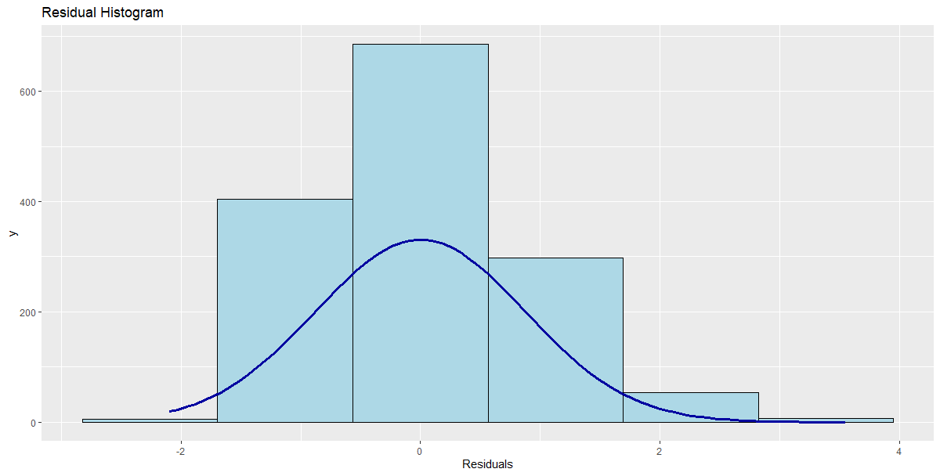
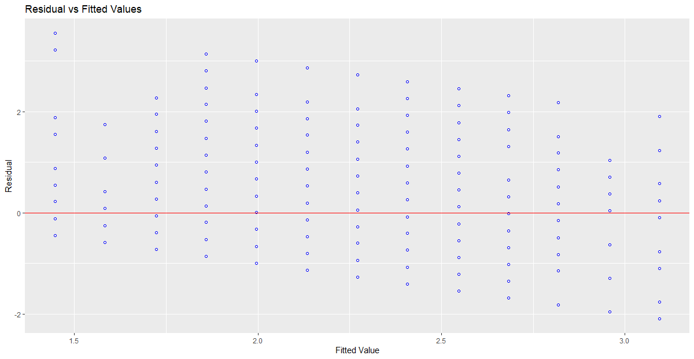
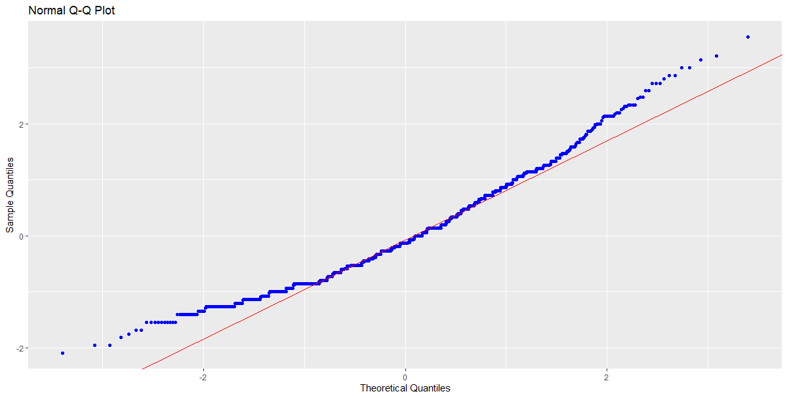
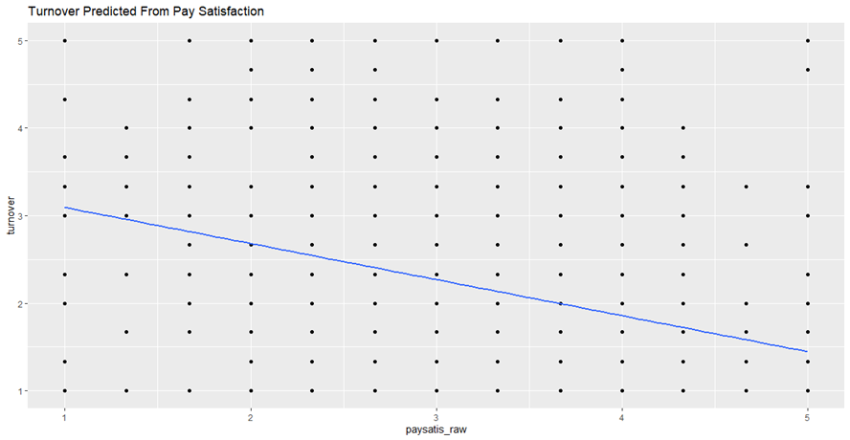
Diagnostics: Turnover ~ Pay Satisfaction

Slide 8

Multiple Regression in R
PsychoStat

Slide 9
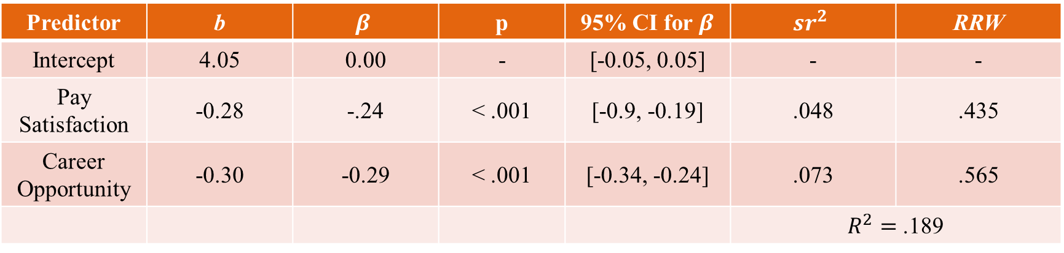
Multiple Reg: Turnover ~ Pay Satisfaction + Career Opportunity
Predictor | b | $$β$$ | p | 95% CI for $β$ | $${sr}^{2}$$ | RRW
Intercept | 4.05 | 0.00 | - | [-0.05, 0.05] | - | -
Pay Satisfaction | -0.28 | -.24 | < .001 | [-0.9, -0.19] | .048 | .435
Career Opportunity | -0.30 | -0.29 | < .001 | [-0.34, -0.24] | .073 | .565
 |  |  |  |  | $R^{2}=$ .189
Note. RRW = Rescaled Relative Weights; ${sr}^{2}$= squared semi-partial correlations

Slide 10
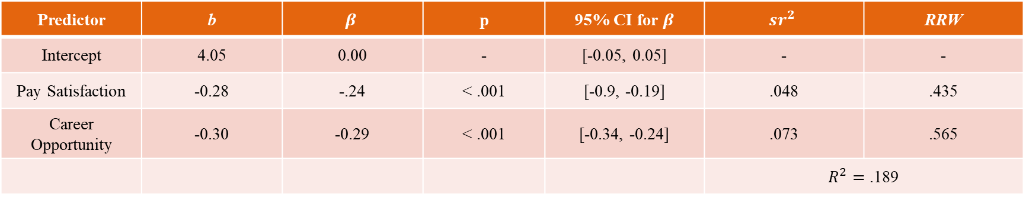
Interpretation (1): Turnover ~ Pay Satisfaction + Career Opportunity
Predictor | b | $$β$$ | p | 95% CI for $β$ | $${sr}^{2}$$ | RRW
Intercept | 4.05 | 0.00 | - | [-0.05, 0.05] | - | -
Pay Satisfaction | -0.28 | -.24 | < .001 | [-0.9, -0.19] | .048 | .435
Career Opportunity | -0.30 | -0.29 | < .001 | [-0.34, -0.24] | .073 | .565
 |  |  |  |  | $R^{2}=$ .189
The predicted level of T/O intent for individuals with zero pay satisfaction and zero career opp is 4.05.
For every 1-unit increase in pay satisfaction, T/O intent is predicted to decrease by 0.28 units, controlling for perceived career opportunity.
Comparing employees who have the same perceived career opportunities, but who differ by 1 unit on pay satisfaction, we would expect a difference in T/O intentions of -0.28 units
For every 1-unit increase in perceived career opportunity, T/O intent is predicted to decrease by 0.30 units, controlling for pay satisfaction.
Comparing employees who have the same pay satisfaction, but who differ by 1 unit on perceived career opportunities, we would expect a difference in T/O intentions of -0.30 units

Slide 11
Interpretation (2): Turnover ~ Pay Satisfaction + Career Opportunity
Predictor | b | $$β$$ | p | 95% CI for $β$ | $${sr}^{2}$$ | RRW
Intercept | 4.05 | 0.00 | - | [-0.05, 0.05] | - | -
Pay Satisfaction | -0.28 | -.24 | < .001 | [-0.9, -0.19] | .048 | .435
Career Opportunity | -0.30 | -0.29 | < .001 | [-0.34, -0.24] | .073 | .565
 |  |  |  |  | $R^{2}=$ .189
For every 1-SD increase in pay satisfaction, T/O intentions are predicted to decrease by 0.24 SD’s when controlling for perceived career opp. For every 1-SD increase in perceived career opp, T/O intentions are predicted to decrease by 0.29 SD’s when controlling for pay satisfaction
Of all the variation in turnover intentions, about 4.8% is uniquely explained by pay satisfaction, and about 7.3% is uniquely explained by perceived career opportunities
Of the variation in T/O intentions explained by the model, about 44% is explained by pay satisfaction, and about 57% is explained by perceived career opportunities
Roughly 19% of the variation in T/O intentions can be explained by the model including these 2 predictors

Slide 12
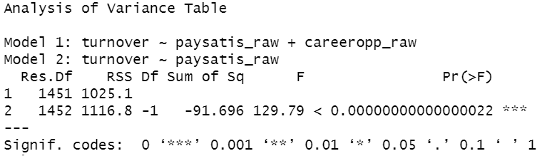
Nested (Hierarchical) Model Comparison
Do perceptions regarding career opportunity predict turnover intentions above and beyond pay satisfaction?
Does adding perceived career opportunities to the model containing pay satisfaction significantly increase model fit?
Yes!

Slide 13
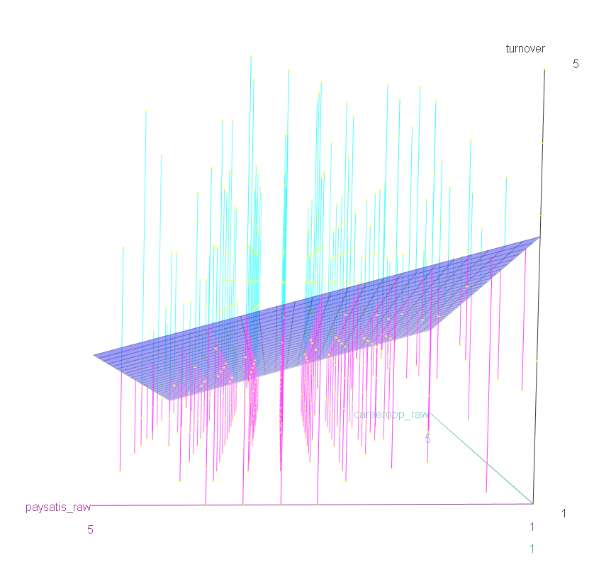
Visualization: Turnover ~ Pay Satisfaction + Career Opps

Slide 14
Diagnostics: Turnover ~ Pay Satisfaction + Career Opp

Slide 15
Categorical Predictors in R

Slide 16

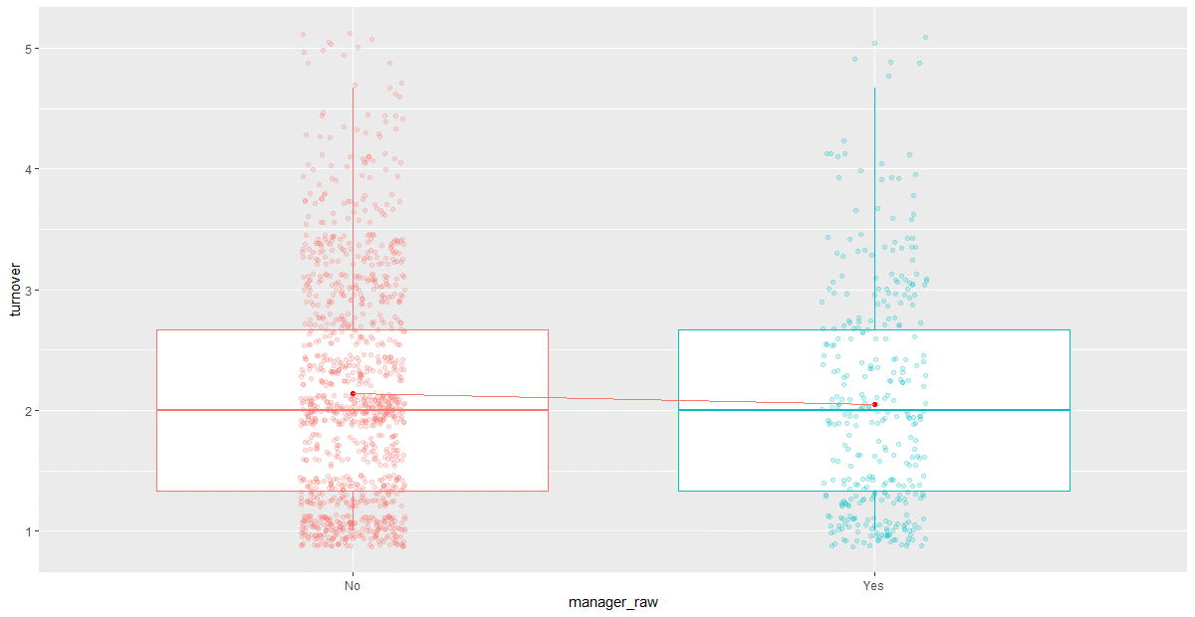

Slide 17
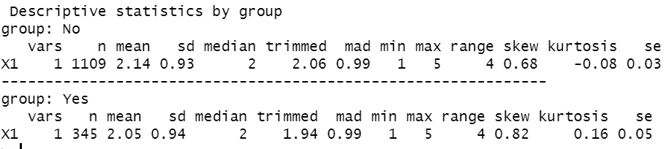
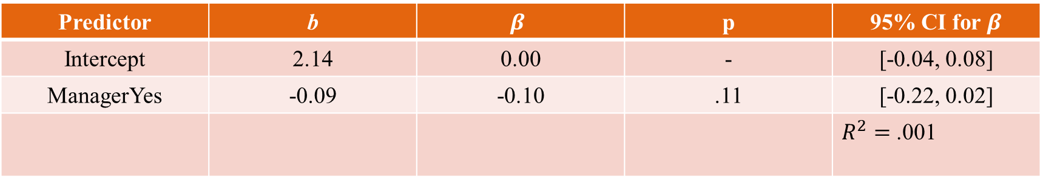
Simple Reg: Turnover ~ Manager Status
Predictor | b | $$β$$ | p | 95% CI for $β$
Intercept | 2.14 | 0.00 | - | [-0.04, 0.08]
ManagerYes | -0.09 | -0.10 | .11 | [-0.22, 0.02]
 |  |  |  | $R^{2}=$ .001

Slide 18
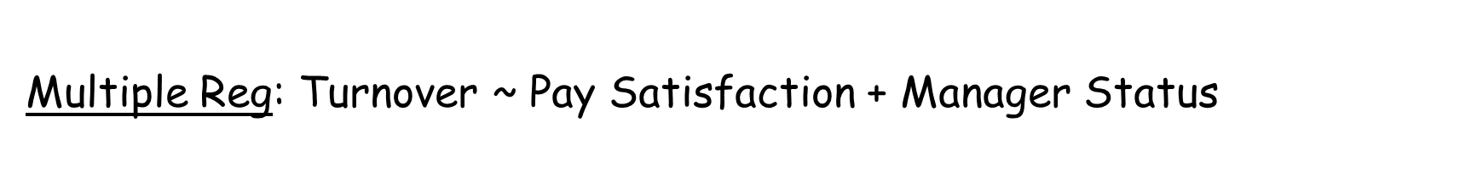
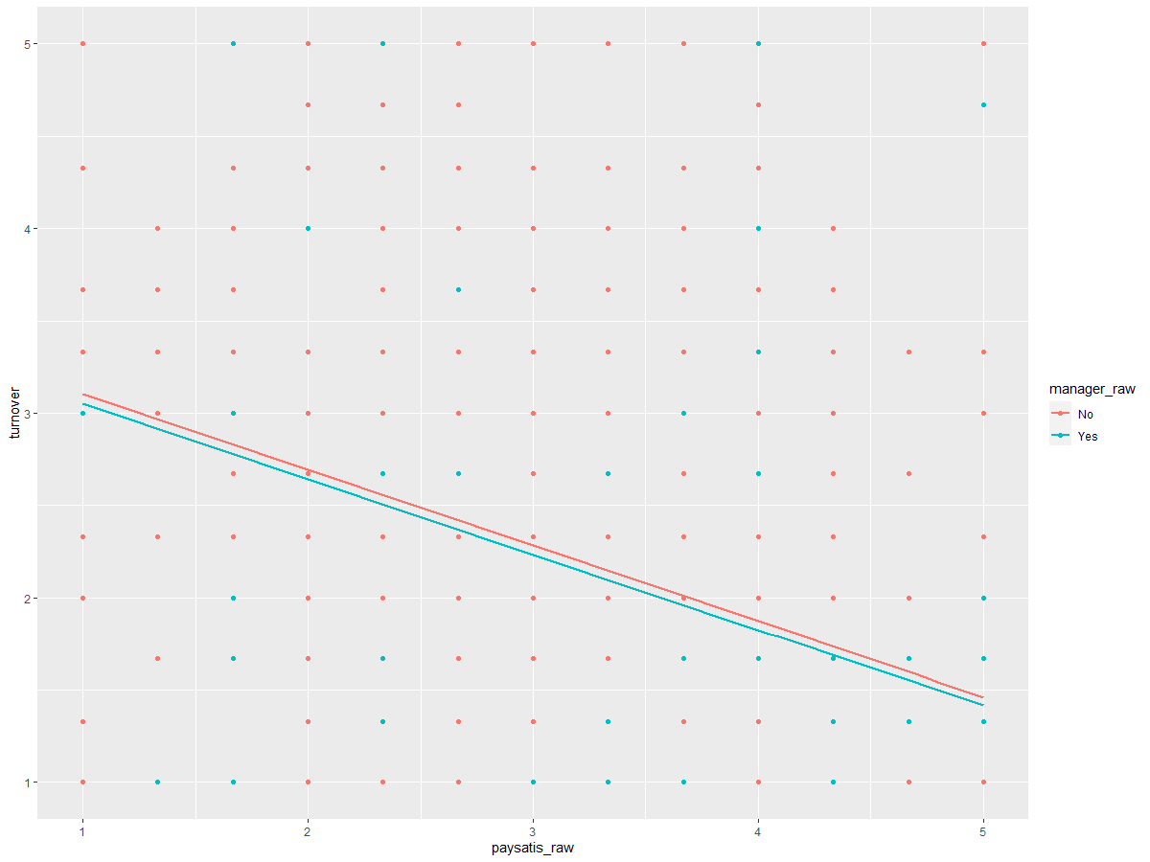

Slide 19
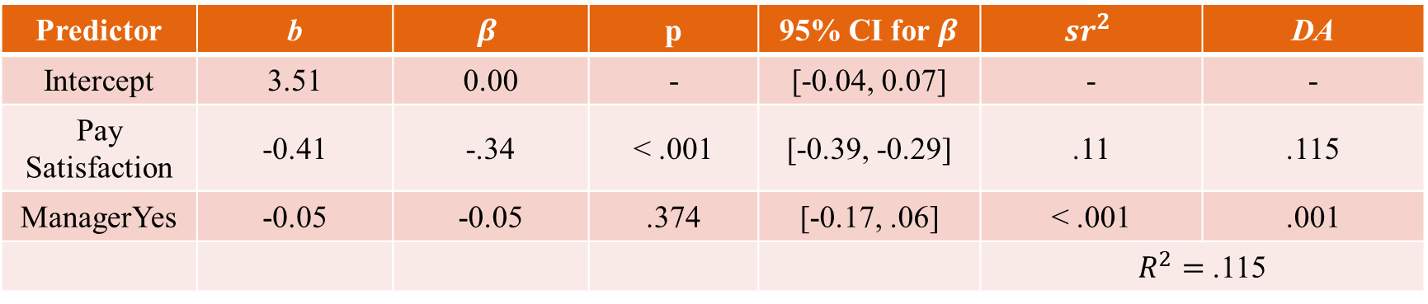
Multiple Reg: Turnover ~ Pay Satisfaction + Manager Status
Predictor | b | $$β$$ | p | 95% CI for $β$ | $${sr}^{2}$$ | DA
Intercept | 3.51 | 0.00 | - | [-0.04, 0.07] | - | -
Pay Satisfaction | -0.41 | -.34 | < .001 | [-0.39, -0.29] | .11 | .115
ManagerYes | -0.05 | -0.05 | .374 | [-0.17, .06] | < .001 | .001
 |  |  |  |  | $R^{2}=$ .115
Note. DA = Dominance Analysis average; ${sr}^{2}$= squared semi-partial correlations

Slide 20
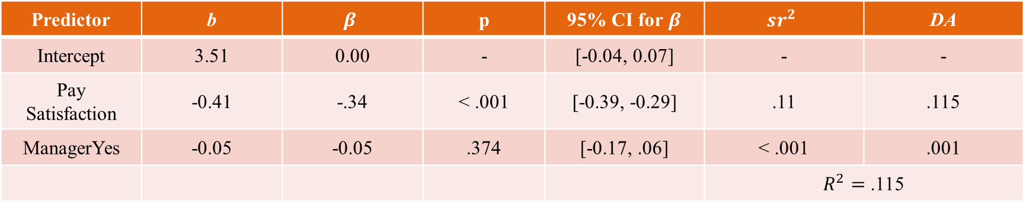
Interpretation (1): Turnover ~ Pay Satisfaction + Manager Status
Predictor | b | $$β$$ | p | 95% CI for $β$ | $${sr}^{2}$$ | DA
Intercept | 3.51 | 0.00 | - | [-0.04, 0.07] | - | -
Pay Satisfaction | -0.41 | -.34 | < .001 | [-0.39, -0.29] | .11 | .115
ManagerYes | -0.05 | -0.05 | .374 | [-0.17, .06] | < .001 | .001
 |  |  |  |  | $R^{2}=$ .115
The predicted level of T/O intent for non-managers with zero pay satisfaction is 3.51.
For every 1-unit increase in pay satisfaction, T/O intent is predicted to decrease by 0.41 units, controlling for manager status.
Comparing employees who have the same manager status, but who differ by 1 unit on pay satisfaction, we would expect a difference in T/O intentions of -0.41 units
Comparing employees who have the same pay satisfaction, we would expect a difference in T/O intentions between managers and non-managers of -0.05 units
Note that this slope/difference is not significant in this case

Slide 21
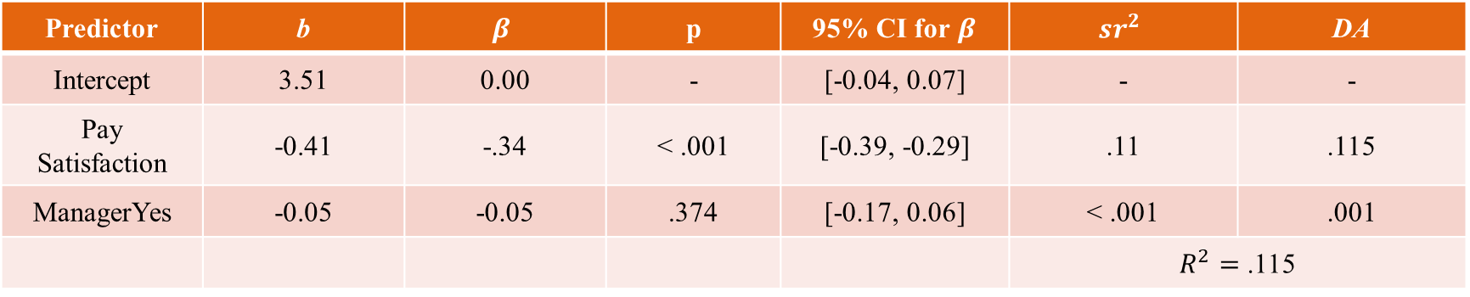
Interpretation (2): Turnover ~ Pay Satisfaction + Manager Status
Predictor | b | $$β$$ | p | 95% CI for $β$ | $${sr}^{2}$$ | DA
Intercept | 3.51 | 0.00 | - | [-0.04, 0.07] | - | -
Pay Satisfaction | -0.41 | -.34 | < .001 | [-0.39, -0.29] | .11 | .115
ManagerYes | -0.05 | -0.05 | .374 | [-0.17, 0.06] | < .001 | .001
 |  |  |  |  | $R^{2}=$ .115
For every 1-SD increase in pay satisfaction, T/O intentions are predicted to decrease by 0.34 SD’s when controlling for manager status. The standardized coefficient for manager status is non-sensical.
Of all the variation in turnover intentions, about 11% is uniquely explained by pay satisfaction, and less than .01% is uniquely explained by manager status
Dominance analysis results confirm that pay satisfaction has a drastically greater “relative importance”
Roughly 11.6% of the variation in T/O intentions can be explained by the model including these 2 predictors

Slide 22
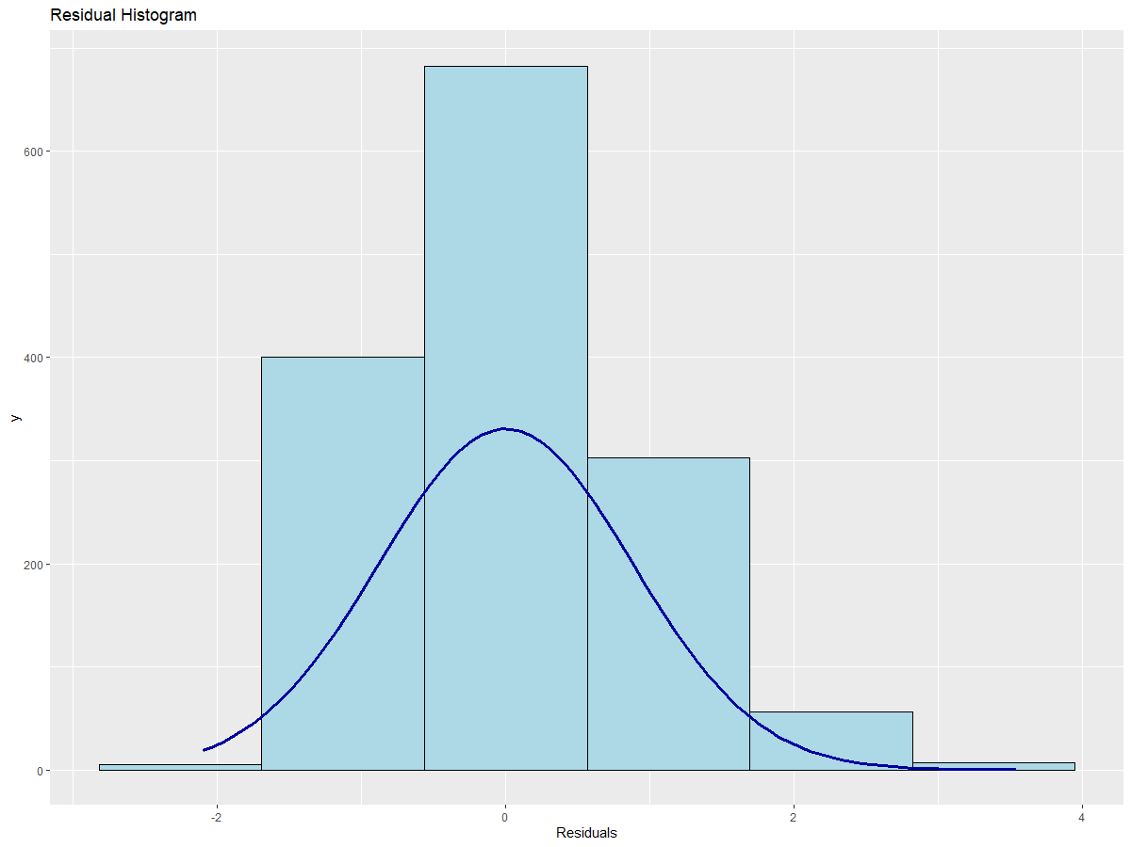
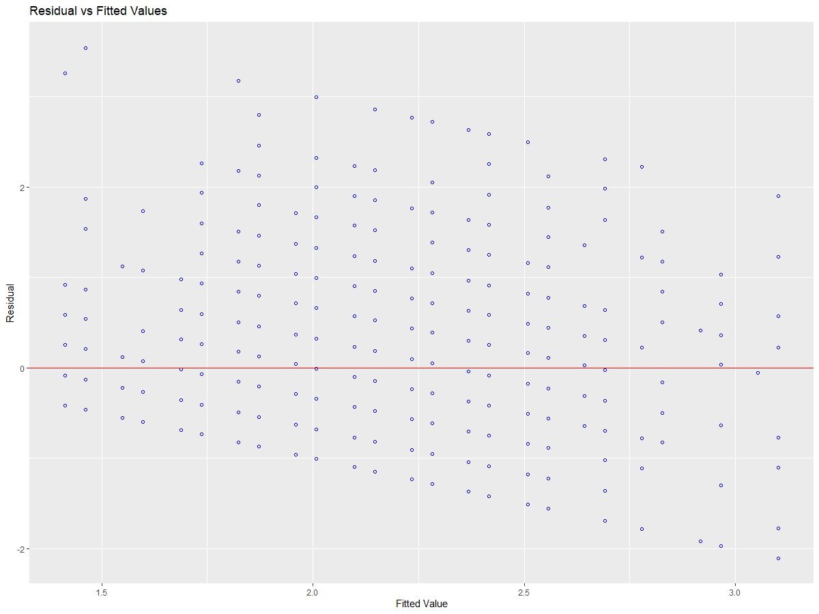
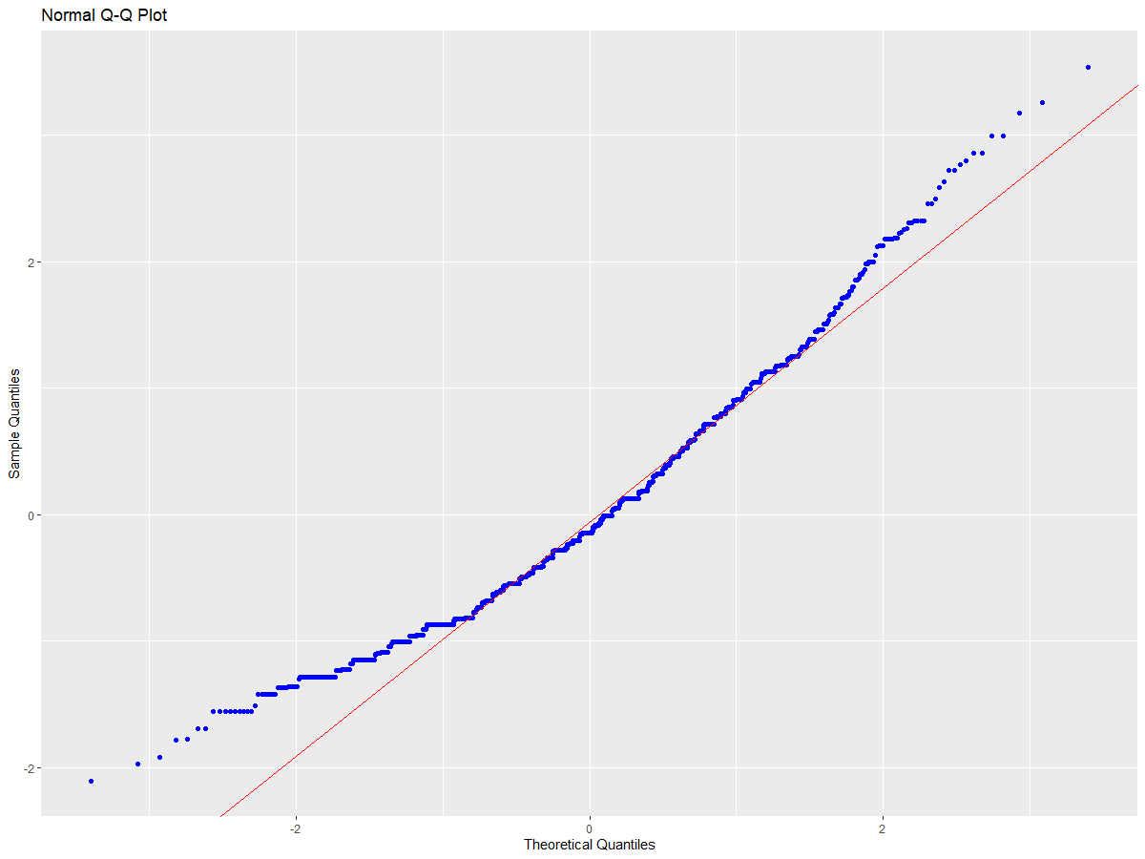
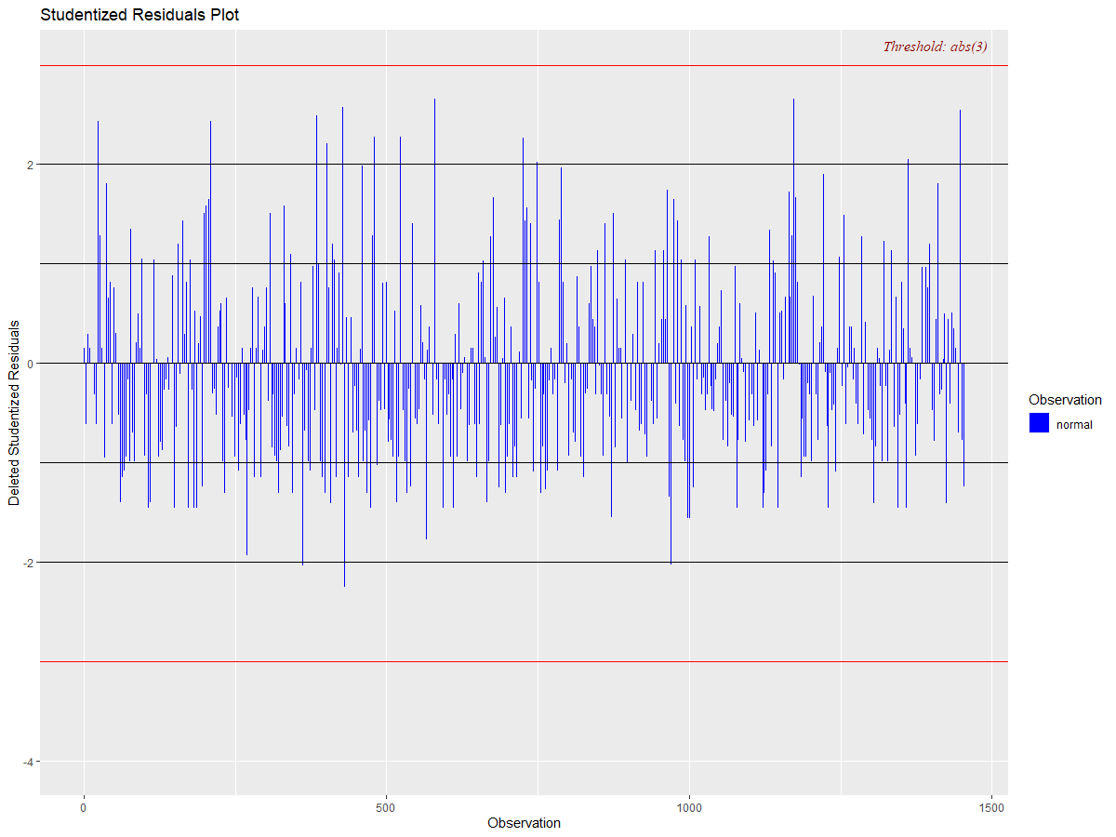
Diagnostics: Turnover ~ Pay Satisfaction + Manager Status

Slide 23
Mean-Centering Predictors

Slide 24
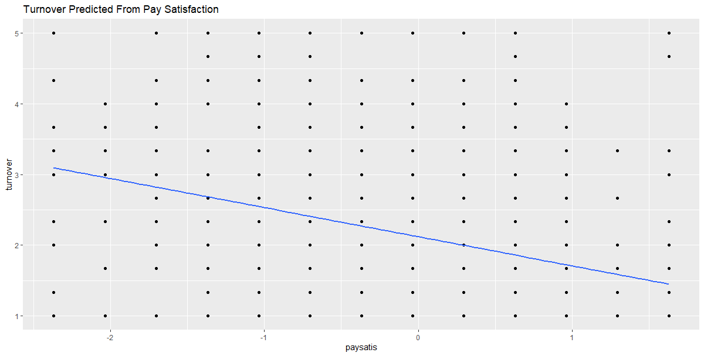
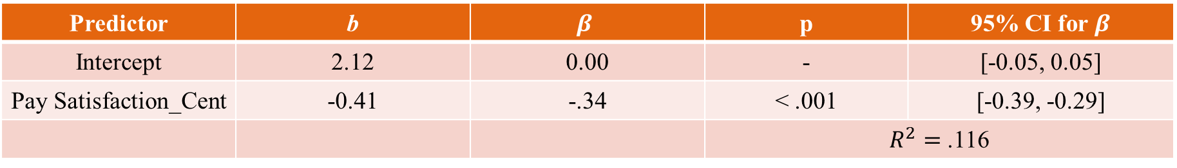
Mean_Centered: Turnover ~ Pay Satisfaction
Predictor | b | $$β$$ | p | 95% CI for $β$
Intercept | 2.12 | 0.00 | - | [-0.05, 0.05]
Pay Satisfaction_Cent | -0.41 | -.34 | < .001 | [-0.39, -0.29]
 |  |  | $R^{2}=$ .116

Slide 25
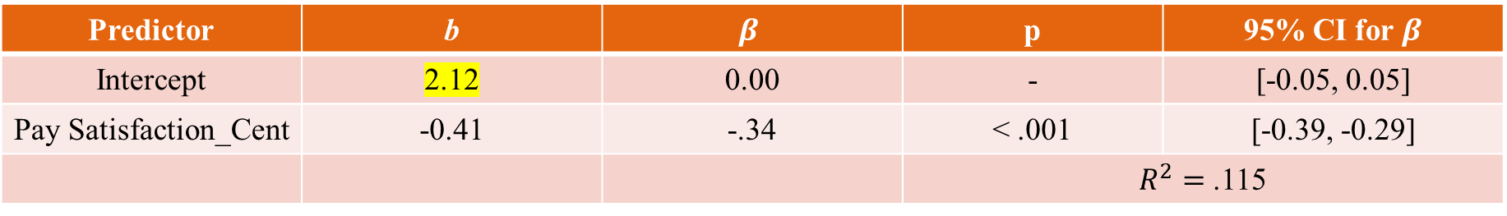
Mean-Centered: Turnover ~ Pay Satisfaction
Predictor | b | $$β$$ | p | 95% CI for $β$
Intercept | 2.12 | 0.00 | - | [-0.05, 0.05]
Pay Satisfaction_Cent | -0.41 | -.34 | < .001 | [-0.39, -0.29]
 |  |  | $R^{2}=$ .115
The predicted level of turnover intentions for individuals with average levels of pay satisfaction is 2.12.
For every 1-unit increase in pay satisfaction, turnover intentions are predicted to decrease by 0.41 units.
Mean-centering does not change the slope, just the intercept!
For every 1-standard deviation increase in pay satisfaction, turnover intentions are predicted to decrease by 0.34 standard deviations
Roughly 11.5% of the variation in turnover intentions is explained by pay satisfaction.

Slide 26
Interaction Terms in R

Slide 27
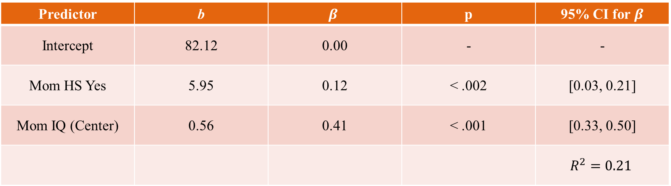
Main Effects: Child IQ ~ Mom HS + Mom IQ (Centered)
Predictor | b | $$β$$ | p | 95% CI for $β$
Intercept | 82.12 | 0.00 | - | -
Mom HS Yes | 5.95 | 0.12 | < .002 | [0.03, 0.21]
Mom IQ (Center) | 0.56 | 0.41 | < .001 | [0.33, 0.50]
 |  |  |  | $$R^{2}=0.21$$

Slide 28
Interaction: Child IQ ~ Mom HS + Mom IQ + Mom HS*Mom IQ

Slide 29
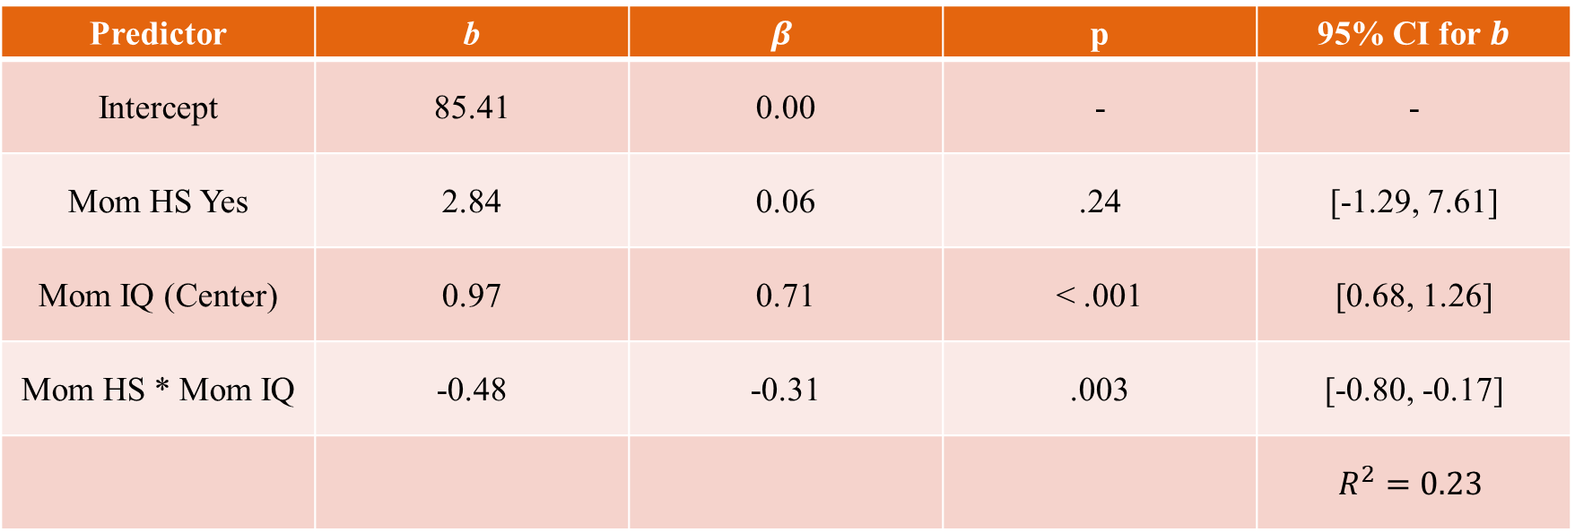
Interaction: Child IQ ~ Mom HS + Mom IQ (Centered) + Mom HS*Mom IQ
Predictor | b | $$β$$ | p | 95% CI for $b$
Intercept | 85.41 | 0.00 | - | -
Mom HS Yes | 2.84 | 0.06 | .24 | [-1.29, 7.61]
Mom IQ (Center) | 0.97 | 0.71 | < .001 | [0.68, 1.26]
Mom HS * Mom IQ | -0.48 | -0.31 | .003 | [-0.80, -0.17]
 |  |  |  | $$R^{2}=0.23$$

Slide 30
Interaction: Child IQ ~ Mom HS + Mom IQ (Centered) + Mom HS*Mom IQ
Intercept: Predicted IQ for children whose moms did not complete high school (HS = 0) and had IQs of 0
Mean-centered Mom IQ, so -> predicted IQ for kids whose moms had no HS and average IQ
Mom HS slope: Predicted change in IQ between kids whose moms had no HS degree (HS = 0) and average IQ and kids whose moms did have a HS degree (HS = 1) and average IQ
Mom IQ slope: Predicted change in kids’ IQ associated with a 1-point increase in mom IQ, when mom has no HS degree (HS = 0)
Mom IQ*Mom HS slope: Difference in the slope for Mom IQ for kids whose mothers did have a HS degree (HS = 1)

Slide 31
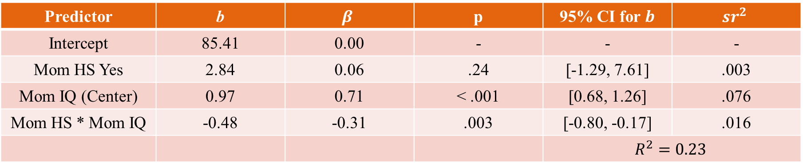
Predictor | b | $$β$$ | p | 95% CI for $b$ | $${sr}^{2}$$
Intercept | 85.41 | 0.00 | - | - | -
Mom HS Yes | 2.84 | 0.06 | .24 | [-1.29, 7.61] | .003
Mom IQ (Center) | 0.97 | 0.71 | < .001 | [0.68, 1.26] | .076
Mom HS * Mom IQ | -0.48 | -0.31 | .003 | [-0.80, -0.17] | .016
 |  |  |  | $$R^{2}=0.23$$
Intercept: Kids whose moms have no HS degree and are of average IQ are predicted to have an IQ of 85.41
Mom HS: Kids whose moms have an average IQ and a HS degree are predicted to have IQ scores that are 2.84 points higher than kids whose moms had no HS degree and average IQ
Mom IQ: For the kids whose moms have no HS degree, each 1-point increase in mom’s IQ is associated with a 0.97-point increase in their own predicted IQ
Mom IQ*Mom HS: For the kids whose moms do have a HS degree, each 1-point increase in mom’s IQ is associated with a 0.49-point increase in their own predicted IQ
Mom IQ slope when no HS degree = 0.97 -> 0.97 + (-0.48) = 0.49

Slide 32
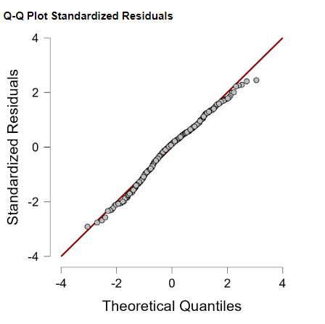
Diagnostics: Child IQ ~ Mom HS + Mom IQ + Mom HS*Mom IQ

Slide 33
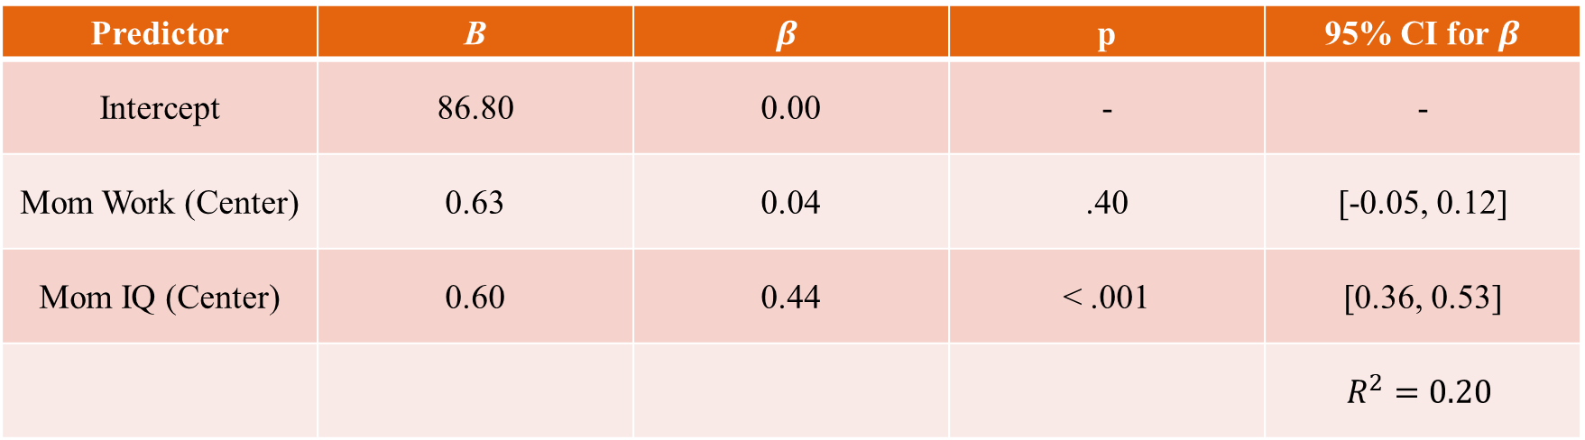
Main Effects: Child IQ ~ Mom Work (Cent) + Mom IQ (Cent)
Predictor | B | $$β$$ | p | 95% CI for $β$
Intercept | 86.80 | 0.00 | - | -
Mom Work (Center) | 0.63 | 0.04 | .40 | [-0.05, 0.12]
Mom IQ (Center) | 0.60 | 0.44 | < .001 | [0.36, 0.53]
 |  |  |  | $$R^{2}=0.20$$

Slide 34
Interaction: Child IQ ~ Mom HS + Mom IQ + Mom HS*Mom IQ

Slide 35
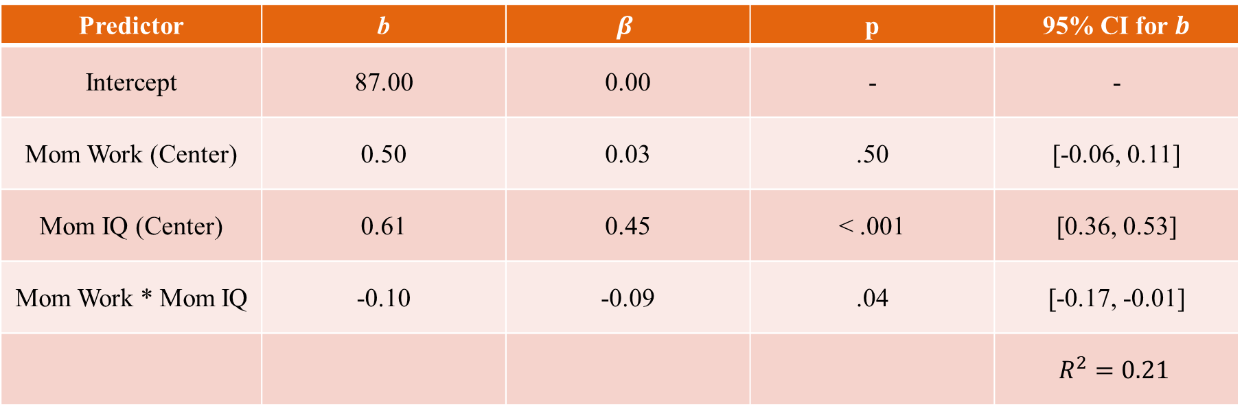
Interaction: Child IQ ~ Mom HS + Mom IQ (Centered) + Mom HS*Mom IQ
Predictor | b | $$β$$ | p | 95% CI for $b$
Intercept | 87.00 | 0.00 | - | -
Mom Work (Center) | 0.50 | 0.03 | .50 | [-0.06, 0.11]
Mom IQ (Center) | 0.61 | 0.45 | < .001 | [0.36, 0.53]
Mom Work * Mom IQ | -0.10 | -0.09 | .04 | [-0.17, -0.01]
 |  |  |  | $$R^{2}=0.21$$

Slide 36
Interaction: Child IQ ~ Mom HS + Mom IQ + Mom HS*Mom IQ

Slide 37
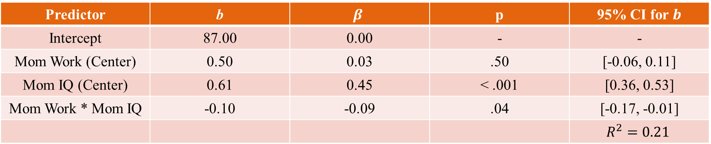
Predictor | b | $$β$$ | p | 95% CI for $b$
Intercept | 87.00 | 0.00 | - | -
Mom Work (Center) | 0.50 | 0.03 | .50 | [-0.06, 0.11]
Mom IQ (Center) | 0.61 | 0.45 | < .001 | [0.36, 0.53]
Mom Work * Mom IQ | -0.10 | -0.09 | .04 | [-0.17, -0.01]
 |  |  |  | $$R^{2}=0.21$$
Intercept: Kids whose moms work an average number of hours and have an average IQ have a predicted IQ of 87
Mom Work: For the kids whose moms have an average IQ, each 1-hour increase in mom’s work hours is associated with a 0.50-point increase in predicted IQ
Mom IQ: For the kids whose moms work an average number of hours, each 1-point increase in mom’s IQ is associated with a 0.61-point increase in their own predicted IQ
Mom IQ*Mom HS: The slope for mom’s IQ decreases by 0.10 for every 1-hour increase in mom’s work hours past the average number of work hours
Mom IQ slope at average work = 0.61 -> IQ slope at avg work + 1hr = 0.61 + (-0.10) = 0.51

Slide 38
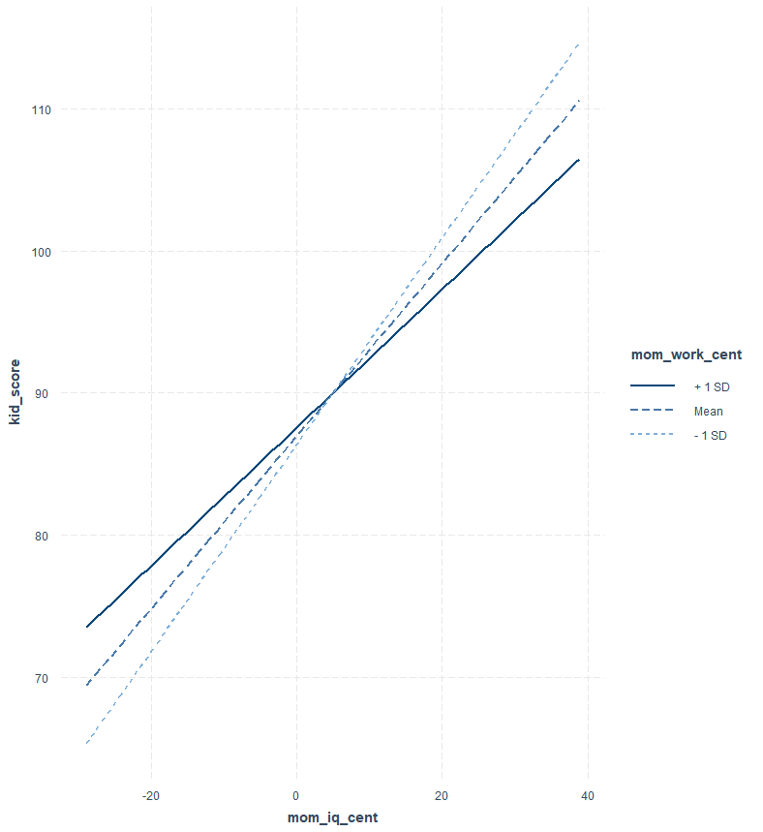
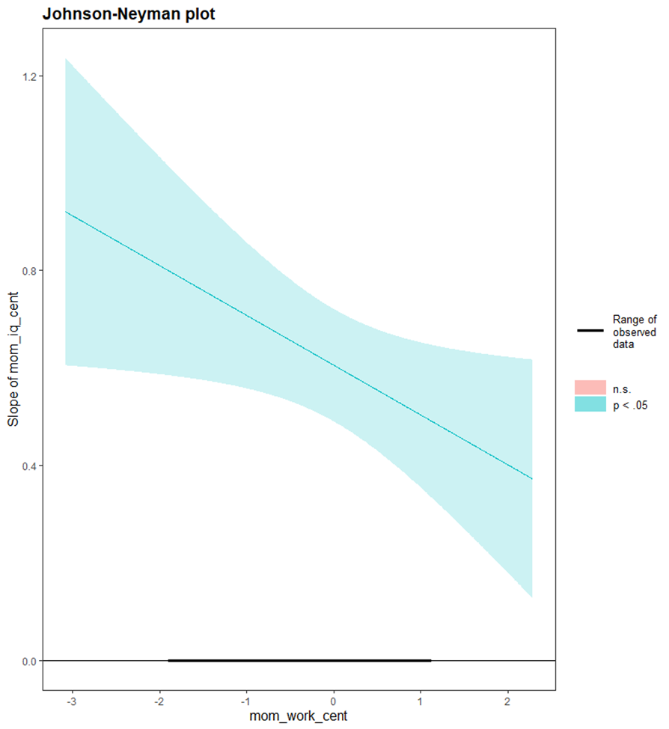
Summary
Mom’s work hours moderates the relationship between Mom’s IQ and Child’s IQ.
Mom’s IQ is a significant positive predictor at all levels of hours worked, but the magnitude decreases with work.
As Mom’s work hours increase, the effect of Mom’s IQ upon Child’s IQ decreases

Slide 39
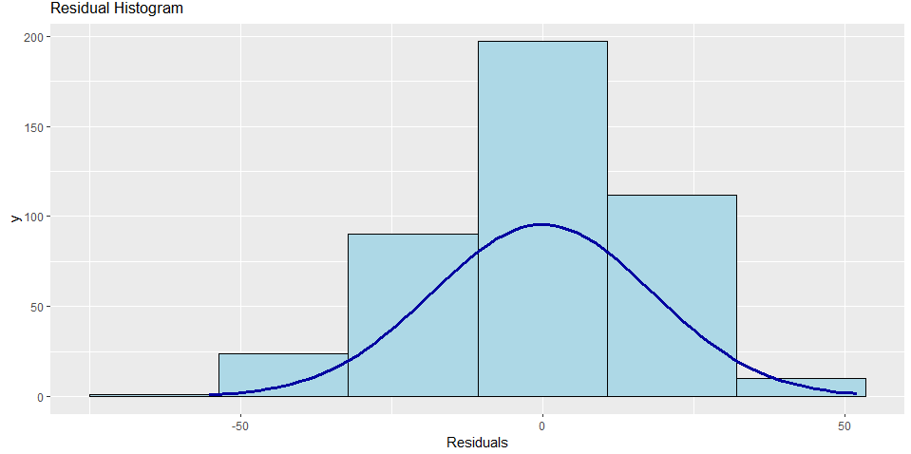
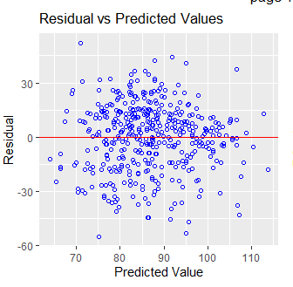
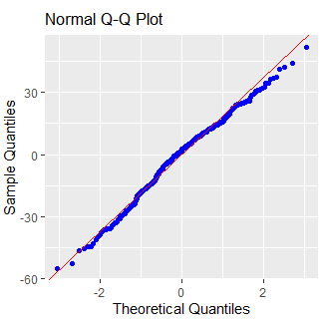
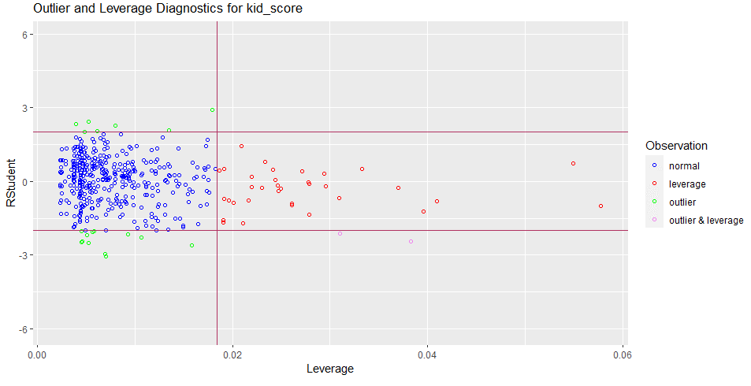
Diagnostics: Child IQ ~ Mom IQ + Mom Work + Mom Work*IQ

